Slide 1
Instructional Services:
Budget Presentation
MONTGOMERY TOWNSHIP SCHOOLS
Montgomery Township School District
2014-2015

Slide 2
MONTGOMERY TOWNSHIP SCHOOLS
Instructional Budget Priorities
Budget Goal I
To develop specific communication protocols with parents, staff and community members that is consistent in message and reflects the vision of “Connected, Known and Valued,” with particular focus on the implementation of AchieveNJ and curriculum initiatives.
Budget Goal II:
To review, evaluate and assess current programs and staffing structures to determine gaps/needs; make specific recommendations to the board to address in a fiscally responsible and efficient manner in the following areas: special education, student/staff attendance and the organizational management structure of the district.
Budget Goal III:
To identify and implement social-emotional programming appropriate for all schools by June 2014 and identify the appropriate assessments to measure the efficacy of the programs.
Notes:
Communication expands with Supervisory Staff
Shared perspectives on Instruction, Assessment and Technology are enabled by Instructional Services team that develops

Slide 3
Budget Goal I
To develop specific communication protocols with parents, staff and community members that is consistent in message and reflects the vision of “Connected, Known and Valued,” with particular focus on the implementation of AchieveNJ and curriculum initiatives.
Staffing leadership team: Building capacity among all of the professionals in the district promoting a shared vision of teaching and learning
Expanding support of professional development through both internal and external learning opportunities: Creating a common perspective around instruction and technology
Leveraging technology advancements to create a stronger school to home connection:
Classroom Instruction
Assessment Data

Slide 4
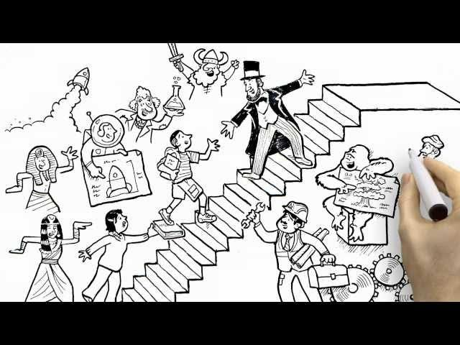
Budget Goal II:
To review, evaluate and assess current programs and staffing structures to determine gaps/needs; make specific recommendations to the board to address in a fiscally responsible and efficient manner in the following areas: special education, student/staff attendance and the organizational management structure of the district.

Slide 5
Budget Goal II:
To review, evaluate and assess current programs and staffing structures to determine gaps/needs; make specific recommendations to the board to address in a fiscally responsible and efficient manner in the following areas: special education, student/staff attendance and the organizational management structure of the district.
Continuing the Alignment of Curriculum and Assessments to New Jersey Core Curriculum Content Standards
Continuing to Build on the Partnership with Columbia University Teacher’s College: Expanding Grade Levels to Encompass Grades K-8
Continuing the Increased Emphasis on Instructional Technology
Preparing Teachers and Students for Partnership for Assessment of Readiness for College and Career (PARCC) Assessments in 2014-15

Slide 6
Budget Goal III:
To identify and implement social-emotional programming appropriate for all schools by June 2014 and identify the appropriate assessments to measure the efficacy of the programs.
Providing learning opportunities promoting greater teacher effectiveness, higher student achievement, and improved school climate
Providing time for teachers to learn and work together. Developing and using formative and summative assessments to evaluate student growth and program efficacy.
Increasing student and faculty collaboration through real time digital tools
Designing the instructional space to effectively meet the requirements of 21st Century Learning

Slide 7
Instructional Technology
Mobility
Access
Collaboration
Resources
PARCC Readiness
Seamless Infusion
Cohesive Vision

Slide 8
Staff to Support the Goals - Proposed
UMS Math Teacher
MHS H/PE Teacher
MHS Academic Support (LA)
Social Worker (K-12)
2 In-Class Support Teachers
2 Language Learning Disabled Teachers
Autism Teacher
Wilson Reading Teacher
BCBA (Board Certified Behavior Analyst) (K-12)
Guidance Counselor (K-4)
Advisors
Math Counts Advisor
Math/Science Club Advisor
Coaches:
MHS Girls Volleyball
MHS Dance Team
MHS Diving
UMS Boys Lacrosse
UMS Girls Lacrosse

Slide 10
Budget Emphases for 2014-2015
Increased Student Confidence and Success in Reading and Writing
Mastery of Math Content, Process, Application with a Depth that Promotes Critical Thinking and Transfer of Skills
Common Learning Experience Across Grade Levels and Classrooms
Ready Access to a Variety of Digital Tools to Gather, Apply and Use Information
Connected Learning Opportunities
Notes:
We have talked about what the adults are doing, but lets talk about the impacts on the children

